Slide 1


Warning Signs of Heart Attack
Aphasia-friendly toolkit March 2024
Disclaimer: These materials were created using funding from the Provincial Community Stroke Rehabilitation Initiative and crafted by Aran Oberle, Speech Language Pathologist, with input from regional rehab programs. They are not meant to replace professional expertise. Readers should seek advice from a qualified healthcare provider for any concerns. The content of this PowerPoint can be adjusted to suit the needs of healthcare professionals. Users are accountable for confirming the accuracy and suitability of the information for their unique situations.

Slide 2





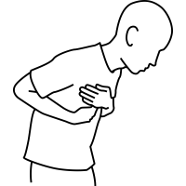


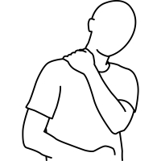
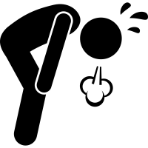

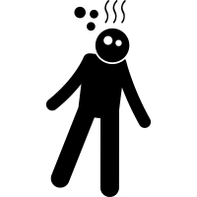
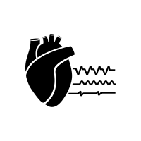
STOP immediately and get medical help if you feel:
    Chest pain or pressure
    Jaw/neck pain
    Arm pain
    Shoulder/back pain
    Short of breath
    Dizzy
    Light-headed
    Irregular heart rate
Adapted from: Heart attack. National Heart, Lung, and Blood Institute. https://www.nhlbi.nih.gov/health/heart-attack/causes. Accessed March 20, 2023.

Slide 3
ARRÊTER et chercher de l'aide médicale immédiate
si vous avez:
    Douleurs ou pression au niveau de la poitrine
    Douleur à la machoire ou au cou
    Douleur au long du bras
    Douleur traversant la poitrine et le dos
    L'essoufflement inhabituel
    Étourdissements
    Rhythme cardiaque irrégulier
Adapté de: Heart attack. National Heart, Lung, and Blood Institute. https://www.nhlbi.nih.gov/health/heart-attack/causes. Accessed March 20, 2023.

