Slide 1


Stroke Etiology and Medical Update Handout
Aphasia-friendly toolkit March 2024
Disclaimer: These materials were created using funding from the Provincial Community Stroke Rehabilitation Initiative and crafted by Aran Oberle, Speech Language Pathologist, with input from regional rehab programs. They are not meant to replace professional expertise. Readers should seek advice from a qualified healthcare provider for any concerns. The content of this PowerPoint can be adjusted to suit the needs of healthcare professionals. Users are accountable for confirming the accuracy and suitability of the information for their unique situations.

Slide 2









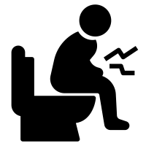

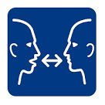
Name: Doctor:
You had a STROKE.
Type of stroke:
Where:
Bleed
Blood clot
RIGHT
LEFT
​
Medications: ​
Blood Thinner​
Blood Pressure​
Diabetes​
Cholesterol​
Mood/Pain​
Constipation​
Leg Clot Prevention​
Bone Health​
​
Tests:

Slide 3
Nom: Médecin:
Vous avez eu un AVC.
Type d' AVC:
Où:
Saignement
Caillot sanguin
DROITE
GAUCHE
​
Medicamments: ​
Fluidifier le sang
Tension artérielle​
Diabète
Cholestérol
Humeur
Constipation​
Prévention des caillots sanguins​
Prévention des fractures
​
Tests:

