Slide 1


PT
Gym Activity Choice
Aphasia-friendly toolkit March 2024
Disclaimer: These materials were created using funding from the Provincial Community Stroke Rehabilitation Initiative and crafted by Aran Oberle, Speech Language Pathologist, with input from regional rehab programs. They are not meant to replace professional expertise. Readers should seek advice from a qualified healthcare provider for any concerns. The content of this PowerPoint can be adjusted to suit the needs of healthcare professionals. Users are accountable for confirming the accuracy and suitability of the information for their unique situations.

Slide 2

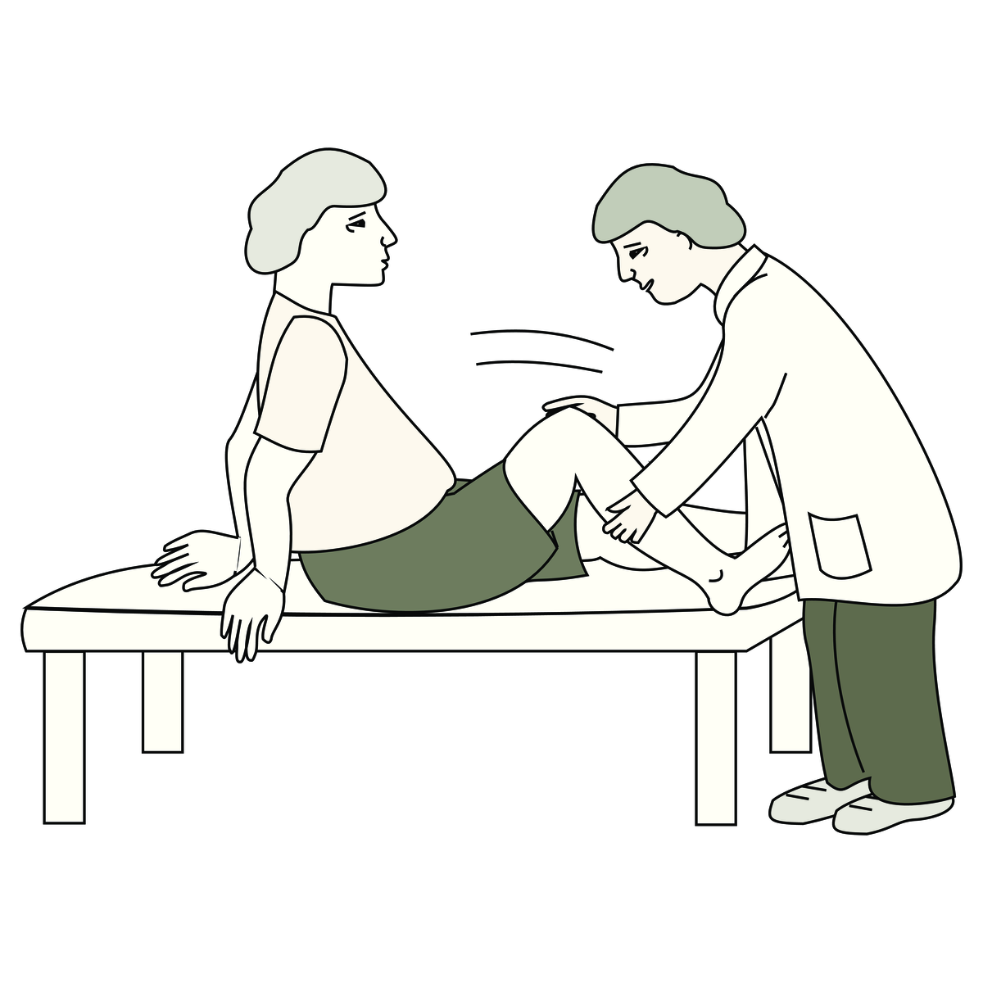
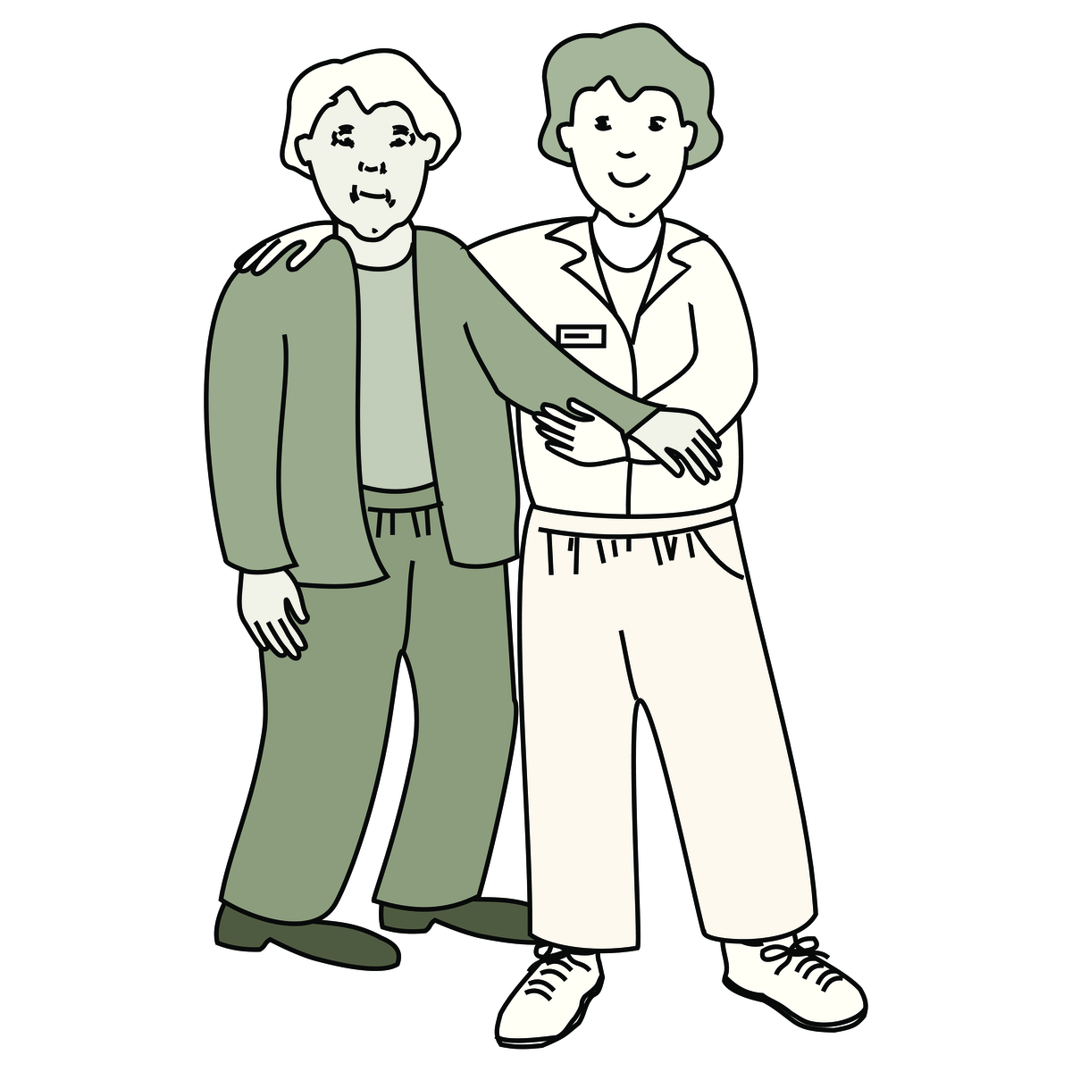
Physiotherapy
with
Physiotherapist (PT)
Rehabilitation Assistant (RA)
Images used are from ParticiPics – a free, searchable database of pictographic images developed by the Aphasia Institute,
https://www.aphasia.ca/participics

Slide 3
Physiothérapie
avec
Physiothérapeute (PT)
Assistant de réadaptation (RA)
Images used are from ParticiPics – a free, searchable database of pictographic images developed by the Aphasia Institute,
https://www.aphasia.ca/participics

Slide 4

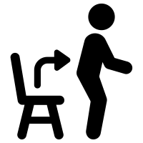
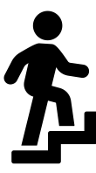

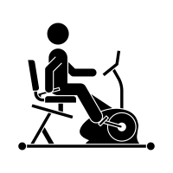
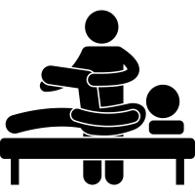




Physiotherapy Activities
Parallel bars
Sit to stand
Stairs
Balance
Bike
Lying down
Walking alone
Walking
with help
Walking
with tool

Slide 5
Activitiés en physiothérapie
Barres parallèles
Assis - debout
Marches
Équilibre
Vélo
Couché
Marcher seul
Marcher avec aide
Marcher avec outil

