Slide 1


Interdisciplinary Team Therapy Goals
Aphasia-friendly toolkit March 2024
Disclaimer: These materials were created using funding from the Provincial Community Stroke Rehabilitation Initiative and crafted by Aran Oberle, Speech Language Pathologist, with input from regional rehab programs. They are not meant to replace professional expertise. Readers should seek advice from a qualified healthcare provider for any concerns. The content of this PowerPoint can be adjusted to suit the needs of healthcare professionals. Users are accountable for confirming the accuracy and suitability of the information for their unique situations.

Slide 2
Document | Slides
Rehab Team | English: 2-3 French: 27-28
Physiotherapy Goals | English: 4 French: 29
Transfers | English: 5-6 French: 30-31
Transfers (wheelchair) | English: 7-8 French: 32-33
Occupational Therapy Goals | English: 9 French: 34
Occupational Therapy ADLs | English: 10-11 French: 35-36
Occupational Therapy IADLs | English: 12 French: 37
Recommended Equipment | English: 13-14 French: 38-39
Speech Therapy Goals | English: 15-16 French: 40-41
Swallow Strategies | English: 17 French: 42
Social Work | English: 18 French: 43
Discharge Plan Destinations | English: 19 French: 44
Family Meeting Goals | English: 20 French: 45
Pharmacy Medication Description | English: 21-24 French: 46-49
Questions | English: 25 French: 50
Lined Paper | English: 26 French: 51

Slide 3







Rehab Team
Doctor:
_______________________________________________
Physiatrist:
_______________________________________________
Pharmacist:
_______________________________________________
Dietitian (RD):
_______________________________________________
Social Worker (SW):
_______________________________________________
Social Service Worker (SSW):
_______________________________________________

Slide 4





Rehab Team
Occupational Therapist (OT):
_______________________________________________
Physiotherapist (PT):
_______________________________________________
Rehab Assistant (RA):
_______________________________________________
Speech-Language Pathologist (SLP):
_______________________________________________
Communication Disorders Assistant (CDA):
_______________________________________________

Slide 5



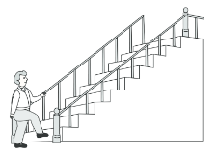
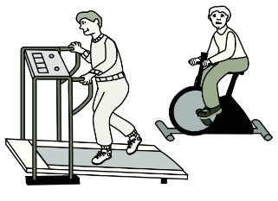
Physiotherapy
Mobility
______________________________________________________
______________________________________________________
______________________________________________________
Walking / Ambulation
______________________________________________________
______________________________________________________
______________________________________________________
Stairs
______________________________________________________
______________________________________________________
______________________________________________________
Endurance
______________________________________________________
______________________________________________________
______________________________________________________
Images used are from ParticiPics – a free, searchable database of pictographic images developed by the Aphasia Institute, ​https://www.aphasia.ca/participics

Slide 6
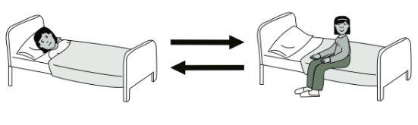
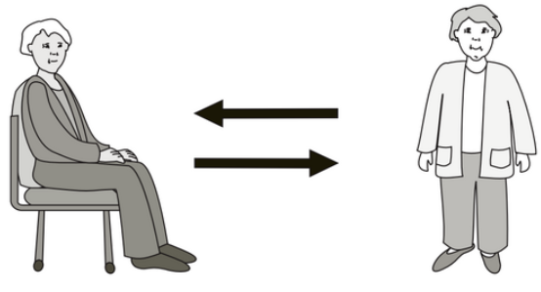
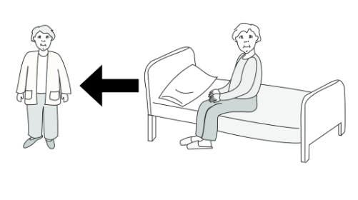
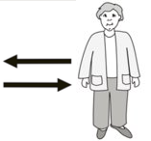
Transfers
In Bed
______________________________________________________
______________________________________________________
______________________________________________________
Sit - Stand
______________________________________________________
______________________________________________________
______________________________________________________
Bed - Stand
______________________________________________________
______________________________________________________
______________________________________________________
______________________________________________________
______________________________________________________
______________________________________________________
Images used are from ParticiPics – a free, searchable database of pictographic images developed by the Aphasia Institute, ​https://www.aphasia.ca/participics

Slide 7
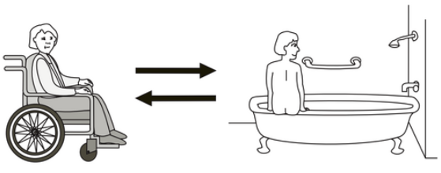
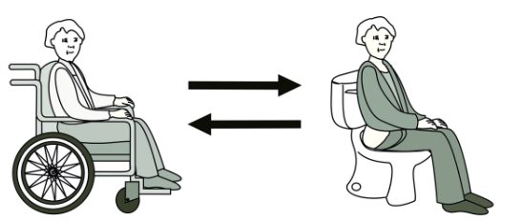
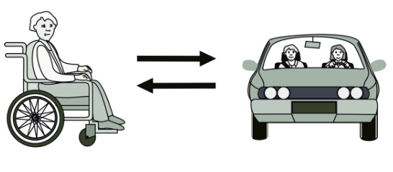

Transfers
Bathtub
______________________________________________________
______________________________________________________
______________________________________________________
Toilet
______________________________________________________
______________________________________________________
______________________________________________________
Car
______________________________________________________
______________________________________________________
______________________________________________________
From floor
______________________________________________________
______________________________________________________
______________________________________________________
Images used are from ParticiPics – a free, searchable database of pictographic images developed by the Aphasia Institute, ​https://www.aphasia.ca/participics

Slide 8

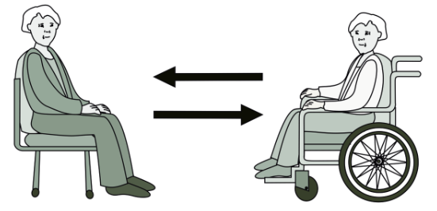
Wheelchair
Transfers
In Bed
______________________________________________________
______________________________________________________
______________________________________________________
Bed - Chair
______________________________________________________
______________________________________________________
______________________________________________________
Wheelchair-chair
______________________________________________________
______________________________________________________
______________________________________________________
______________________________________________________
______________________________________________________
______________________________________________________
Images used are from ParticiPics – a free, searchable database of pictographic images developed by the Aphasia Institute, ​https://www.aphasia.ca/participics

Slide 9
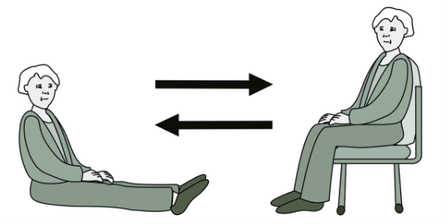
Wheelchair
Transfers
Bathtub
______________________________________________________
______________________________________________________
______________________________________________________
Toilet
______________________________________________________
______________________________________________________
______________________________________________________
Car
______________________________________________________
______________________________________________________
______________________________________________________
From floor
______________________________________________________
______________________________________________________
______________________________________________________
Images used are from ParticiPics – a free, searchable database of pictographic images developed by the Aphasia Institute, ​https://www.aphasia.ca/participics

Slide 10







Occupational Therapy
Physical Difficulties
______________________________________________________
______________________________________________________
______________________________________________________
Cognition Difficulties
______________________________________________________
______________________________________________________
______________________________________________________
Perception Difficulties
______________________________________________________
______________________________________________________
______________________________________________________
Sensation Difficulties
______________________________________________________
______________________________________________________
______________________________________________________

Slide 11




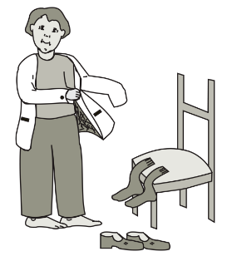

Occupational Therapy
Bathing
______________________________________________________
______________________________________________________
______________________________________________________
Grooming
______________________________________________________
______________________________________________________
______________________________________________________
Dressing Upper Body
______________________________________________________
______________________________________________________
______________________________________________________
Dressing Lower Body
______________________________________________________
______________________________________________________
______________________________________________________
Images used are from ParticiPics – a free, searchable database of pictographic images developed by the Aphasia Institute, ​https://www.aphasia.ca/participics

Slide 12
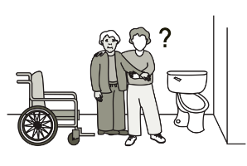
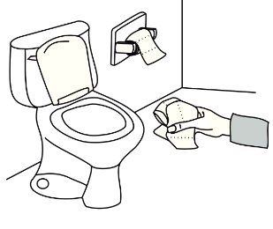
Occupational Therapy
Toileting
______________________________________________________
______________________________________________________
______________________________________________________
Peri Care
______________________________________________________
______________________________________________________
______________________________________________________
______________________________________________________
______________________________________________________
______________________________________________________
______________________________________________________
______________________________________________________
______________________________________________________
Images used are from ParticiPics – a free, searchable database of pictographic images developed by the Aphasia Institute, ​https://www.aphasia.ca/participics

Slide 13


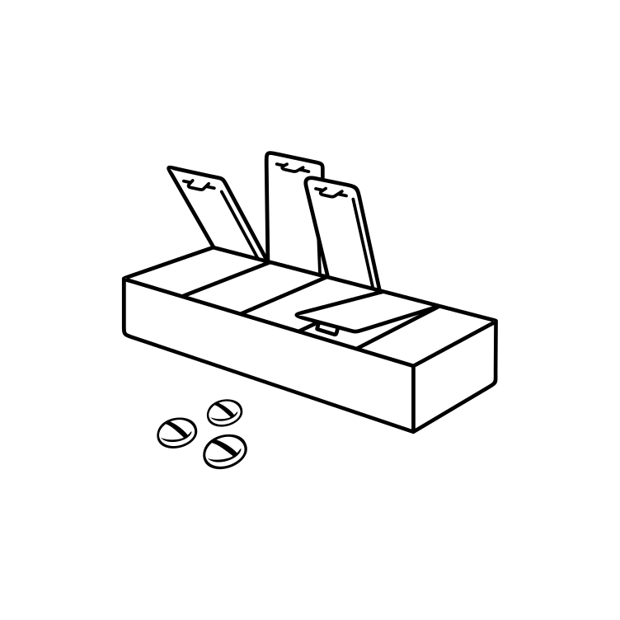


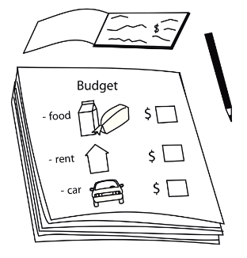


Occupational Therapy
Driving
______________________________________________________
______________________________________________________
______________________________________________________
Managing Medications
______________________________________________________
______________________________________________________
______________________________________________________
Cooking
______________________________________________________
______________________________________________________
______________________________________________________
Finances
______________________________________________________
______________________________________________________
______________________________________________________
Images used are from ParticiPics – a free, searchable database of pictographic images developed by the Aphasia Institute, ​https://www.aphasia.ca/participics

Slide 14


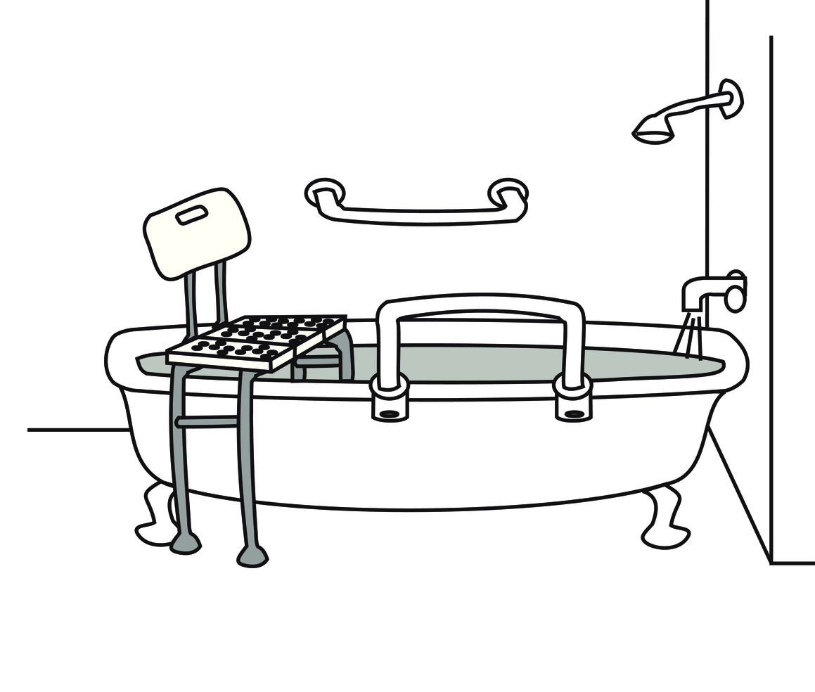




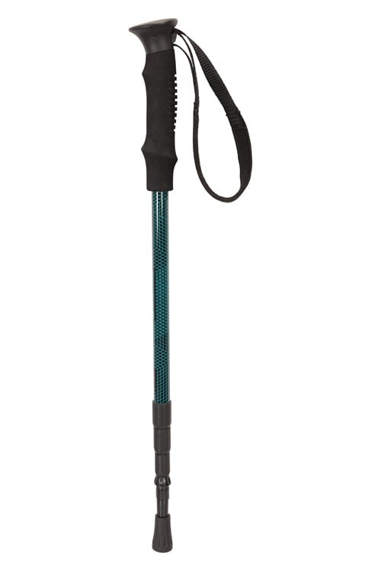
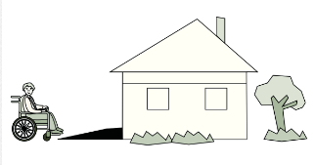
Recommended Equipment
Wheelchair
Walker
Shower chair​​
Toilet riser​​
Grab bars​​
Reacher​​
Adapted utensils
Walking Pole
Ramp
Images used are from ParticiPics – a free, searchable database of pictographic images developed by the Aphasia Institute, ​https://www.aphasia.ca/participics

Slide 15
Recommended Equipment
______________________________
______________________________
______________________________
______________________________
______________________________
______________________________
______________________________
______________________________
______________________________

Slide 16







Speech Therapy
Talking
______________________________________________________
______________________________________________________
______________________________________________________
Listening
______________________________________________________
______________________________________________________
______________________________________________________
Reading
______________________________________________________
______________________________________________________
______________________________________________________
Writing
______________________________________________________
______________________________________________________
______________________________________________________

Slide 17






Speech Therapy
Cognitive Communication
______________________________________________________
______________________________________________________
______________________________________________________
Strategies
______________________________________________________
______________________________________________________
______________________________________________________
Swallowing
______________________________________________________
______________________________________________________
______________________________________________________

Slide 18




Swallow Strategies
Questions? ​​

Slide 19
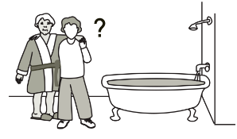





Social Work
Personal Support Services / Homecare (HCCSS)
______________________________________________________
______________________________________________________
______________________________________________________
Financial Supports
______________________________________________________
______________________________________________________
______________________________________________________
Community Programs
______________________________________________________
______________________________________________________
______________________________________________________
Support
______________________________________________________
______________________________________________________
______________________________________________________
Images used are from ParticiPics – a free, searchable database of pictographic images developed by the Aphasia Institute, ​https://www.aphasia.ca/participics

Slide 20
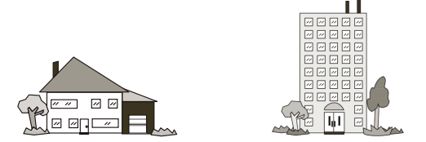
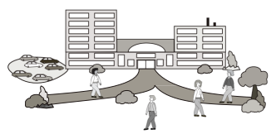
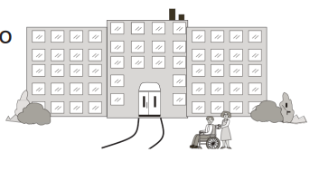
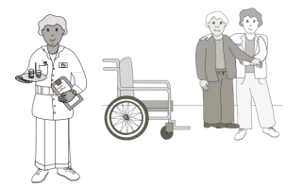
Discharge Plan
Home
______________________________________________________
______________________________________________________
______________________________________________________
Retirement Home/Supportive Housing
______________________________________________________
______________________________________________________
______________________________________________________
Long-Term Care home
______________________________________________________
______________________________________________________
______________________________________________________
________
Images used are from ParticiPics – a free, searchable database of pictographic images developed by the Aphasia Institute, ​https://www.aphasia.ca/participics

Slide 21
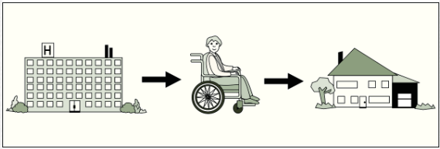
Family Meeting
Meeting with rehab team to discuss:
Progress in therapy
Expectations for recovery
Next steps
Referrals for other services
Family training
__________________________
Discharge from hospital
Images used are from ParticiPics – a free, searchable database of pictographic images developed by the Aphasia Institute, ​https://www.aphasia.ca/participics

Slide 22




Pharmacy
Thin blood
______________________________________________________
______________________________________________________
______________________________________________________
Prevent Blood Clots
______________________________________________________
______________________________________________________
______________________________________________________
Manage Cholesterol
______________________________________________________
______________________________________________________
______________________________________________________
Manage Blood Pressure
______________________________________________________
______________________________________________________
______________________________________________________

Slide 23




Pharmacy
Diabetes
______________________________________________________
______________________________________________________
______________________________________________________
Prevent Fractures
______________________________________________________
______________________________________________________
______________________________________________________
Mood
______________________________________________________
______________________________________________________
______________________________________________________
Sleep
______________________________________________________
______________________________________________________
______________________________________________________

Slide 24




Pharmacy
Protect Stomach
______________________________________________________
______________________________________________________
______________________________________________________
Prevent Seizures
______________________________________________________
______________________________________________________
______________________________________________________
Quit Smoking
______________________________________________________
______________________________________________________
______________________________________________________
Prevent Constipation
______________________________________________________
______________________________________________________
______________________________________________________

Slide 25

Pharmacy
Manage Nerve Pain
______________________________________________________
______________________________________________________
______________________________________________________
______________________________________________________
______________________________________________________
______________________________________________________
______________________________________________________
______________________________________________________
______________________________________________________
______________________________________________________
______________________________________________________
______________________________________________________

Slide 26
Questions?

Slide 27
________________________________________________________________________________________________________________________________________________________________________________________________________________________________________________________________________________________________________________________________________________________________________________________________________________________________________________________________________________________________________________________________________________________________________________________________________________________________________________________________________________________________________________________________________________________________________________________________________________________________________________________________________________________________________________________________________________________________________________________________________________________________________________________________________________________________________________________________________________________________

Slide 28
Mon équipe interprofessionelle
Médecin:
_______________________________________________
Physiatre:
_______________________________________________
Pharmacist:
_______________________________________________
Diététicien(ne) (RD):
_______________________________________________
Travailleur(euse) Socale (SW):
_______________________________________________
Techniciens en travail social (SSW):
_______________________________________________

Slide 29
Mon équipe interprofessionelle
Ergothérapeute (OT):
_______________________________________________
Physiothérapeute (PT):
_______________________________________________
Assistant(e) de réadaptation (RA):
_______________________________________________
Orthophoniste (SLP):
_______________________________________________
Assistant(e) en orthophonie (CDA):
_______________________________________________

Slide 30
Physiothérapie
Mobilité
______________________________________________________
______________________________________________________
______________________________________________________
Marche / Ambulation
______________________________________________________
______________________________________________________
______________________________________________________
Escaliers
______________________________________________________
______________________________________________________
______________________________________________________
Endurance
______________________________________________________
______________________________________________________
______________________________________________________
Images used are from ParticiPics – a free, searchable database of pictographic images developed by the Aphasia Institute, ​https://www.aphasia.ca/participics

Slide 31
Transferts
Au lit
______________________________________________________
______________________________________________________
______________________________________________________
Assis-debout
______________________________________________________
______________________________________________________
______________________________________________________
Lit-debout
______________________________________________________
______________________________________________________
______________________________________________________
______________________________________________________
______________________________________________________
______________________________________________________
Images used are from ParticiPics – a free, searchable database of pictographic images developed by the Aphasia Institute, ​https://www.aphasia.ca/participics

Slide 32
Transferts
Baignoire
______________________________________________________
______________________________________________________
______________________________________________________
Toilette
______________________________________________________
______________________________________________________
______________________________________________________
Voiture
______________________________________________________
______________________________________________________
______________________________________________________
Du sol
______________________________________________________
______________________________________________________
______________________________________________________
Images used are from ParticiPics – a free, searchable database of pictographic images developed by the Aphasia Institute, ​https://www.aphasia.ca/participics

Slide 33
Fauteil roulant
Transferts
Au lit
______________________________________________________
______________________________________________________
______________________________________________________
Lit-chaise
______________________________________________________
______________________________________________________
______________________________________________________
Chaise roulante-chaise
______________________________________________________
______________________________________________________
______________________________________________________
______________________________________________________
______________________________________________________
______________________________________________________
Images used are from ParticiPics – a free, searchable database of pictographic images developed by the Aphasia Institute, ​https://www.aphasia.ca/participics

Slide 34
Fauteil roulant
Transferts
Baignoire
______________________________________________________
______________________________________________________
______________________________________________________
Toilette
______________________________________________________
______________________________________________________
______________________________________________________
Voiture
______________________________________________________
______________________________________________________
______________________________________________________
Du sol
______________________________________________________
______________________________________________________
______________________________________________________
Images used are from ParticiPics – a free, searchable database of pictographic images developed by the Aphasia Institute, ​https://www.aphasia.ca/participics

Slide 35
Érgothérapie
Compétences physiques
______________________________________________________
______________________________________________________
______________________________________________________
Compétences cognitives
______________________________________________________
______________________________________________________
______________________________________________________
Compétences perceptuels
______________________________________________________
______________________________________________________
______________________________________________________
Compétences sensorielles
______________________________________________________
______________________________________________________
______________________________________________________

Slide 36
Ergothérapie
Se laver
______________________________________________________
______________________________________________________
______________________________________________________
La toilette
______________________________________________________
______________________________________________________
______________________________________________________
Habillage du haut du corps
______________________________________________________
______________________________________________________
______________________________________________________
Habillage du bas du corps
______________________________________________________
______________________________________________________
______________________________________________________
Images used are from ParticiPics – a free, searchable database of pictographic images developed by the Aphasia Institute, ​https://www.aphasia.ca/participics

Slide 37
Ergothérapie
Toilette
______________________________________________________
______________________________________________________
______________________________________________________
Soins périmétriques
______________________________________________________
______________________________________________________
______________________________________________________
______________________________________________________
______________________________________________________
______________________________________________________
______________________________________________________
______________________________________________________
______________________________________________________
Images used are from ParticiPics – a free, searchable database of pictographic images developed by the Aphasia Institute, ​https://www.aphasia.ca/participics

Slide 38
Ergothérapie
Conduite
______________________________________________________
______________________________________________________
______________________________________________________
Gestion des médicaments
______________________________________________________
______________________________________________________
______________________________________________________
Cuisiner
______________________________________________________
______________________________________________________
______________________________________________________
Finances
______________________________________________________
______________________________________________________
______________________________________________________
Images used are from ParticiPics – a free, searchable database of pictographic images developed by the Aphasia Institute, ​https://www.aphasia.ca/participics

Slide 39
Équipement recommandé
Fauteil roulant
Déambulateur
Chaise de douche​
Rehausser de toilettes​
Barres d'appui​
Reacher​​
Ustensils adapté
Bâton de marche
Rampe
Images used are from ParticiPics – a free, searchable database of pictographic images developed by the Aphasia Institute, ​https://www.aphasia.ca/participics

Slide 40
Équipement recommandé
______________________________
______________________________
______________________________
______________________________
______________________________
______________________________
______________________________
______________________________
______________________________

Slide 41
Orthophonie
Parler
______________________________________________________
______________________________________________________
______________________________________________________
Écouter
______________________________________________________
______________________________________________________
______________________________________________________
Lire
______________________________________________________
______________________________________________________
______________________________________________________
Écrire
______________________________________________________
______________________________________________________
______________________________________________________

Slide 42
Speech Therapy
Communication Cognitivo-lingusitique
______________________________________________________
______________________________________________________
______________________________________________________
Stratégies
______________________________________________________
______________________________________________________
______________________________________________________
Déglutition
______________________________________________________
______________________________________________________
______________________________________________________

Slide 43
Strategies de déglutition
Questions? ​​

Slide 44
Travail Social
Services d'aide à la personne / soins à domicile
______________________________________________________
______________________________________________________
______________________________________________________
Aides financières
______________________________________________________
______________________________________________________
______________________________________________________
Programmes communautaires
______________________________________________________
______________________________________________________
______________________________________________________
Soutien
______________________________________________________
______________________________________________________
______________________________________________________
Images used are from ParticiPics – a free, searchable database of pictographic images developed by the Aphasia Institute, ​https://www.aphasia.ca/participics

Slide 45
Destination de sortie
À domicile
______________________________________________________
______________________________________________________
______________________________________________________
Maison de retraite/logement supervisé
______________________________________________________
______________________________________________________
______________________________________________________
Maison de soins de longue durée
______________________________________________________
______________________________________________________
______________________________________________________
________
Images used are from ParticiPics – a free, searchable database of pictographic images developed by the Aphasia Institute, ​https://www.aphasia.ca/participics

Slide 46
Réunion de famille
Réunion avec l'équipe de rééducation pour discuter:
Progrès en thérapie
Attentes en matière de rétablissement
Prochaines étapes
Orientations vers d'autres services
Formation de famille
__________________________
Sortie de l'hôpital
Images used are from ParticiPics – a free, searchable database of pictographic images developed by the Aphasia Institute, ​https://www.aphasia.ca/participics

Slide 47
Pharmacie
Fluidifier le sang
______________________________________________________
______________________________________________________
______________________________________________________
Prévenir la formation de caillots sanguins
______________________________________________________
______________________________________________________
______________________________________________________
Gérer le cholestérol
______________________________________________
______________________________________________
______________________________________________
Gestion de la tension artérielle
______________________________________________________
______________________________________________________
______________________________________________________

Slide 48
Pharmacie
Gérer le diabète
______________________________________________________
______________________________________________________
______________________________________________________
Prévenir les fractures
______________________________________________________
______________________________________________________
______________________________________________________
Gérer l'humeur
______________________________________________________
______________________________________________________
______________________________________________________
Gérer le sommeil
______________________________________________________
______________________________________________________
______________________________________________________

Slide 49
Pharmacie
Protéger l'estomac
______________________________________________________
______________________________________________________
______________________________________________________
Prévenir les convulsions
______________________________________________________
______________________________________________________
______________________________________________________
Arrêter de fumer
______________________________________________________
______________________________________________________
______________________________________________________
Prévenir la constipation
______________________________________________________
______________________________________________________
______________________________________________________

Slide 50
Pharmacie
Gérer les douleurs nerveuses
______________________________________________________
______________________________________________________
______________________________________________________
______________________________________________________
______________________________________________________
______________________________________________________
______________________________________________________
______________________________________________________
______________________________________________________
______________________________________________________
______________________________________________________
______________________________________________________

Slide 51
Questions?

Slide 52
________________________________________________________________________________________________________________________________________________________________________________________________________________________________________________________________________________________________________________________________________________________________________________________________________________________________________________________________________________________________________________________________________________________________________________________________________________________________________________________________________________________________________________________________________________________________________________________________________________________________________________________________________________________________________________________________________________________________________________________________________________________________________________________________________________________________________________________________________________________________

