Slide 1


Inpatient Goal
Status Tracking Signs
Aphasia-friendly toolkit Feb 2024
Disclaimer: These materials were created using funding from the Provincial Community Stroke Rehabilitation Initiative and crafted by Aran Oberle, Speech Language Pathologist, with input from regional rehab programs. They are not meant to replace professional expertise. Readers should seek advice from a qualified healthcare provider for any concerns. The content of this PowerPoint can be adjusted to suit the needs of healthcare professionals. Users are accountable for confirming the accuracy and suitability of the information for their unique situations.

Slide 2
Inpatient Goal Status Tracking Signs
Document | Slide
Transfers Walking/Ambulation Stairs | EN: 2 FR: 7
Bathing Dressing Toileting | EN: 3 FR: 8
Safety at home alone Managing Medications Cooking Finances | EN: 4 FR: 9
Speaking Listening Reading/Writing Cognitive-linguistic skills | EN: 5 FR: 10
Swallow strategies | EN: 6 FR: 11

Slide 3


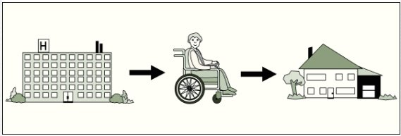
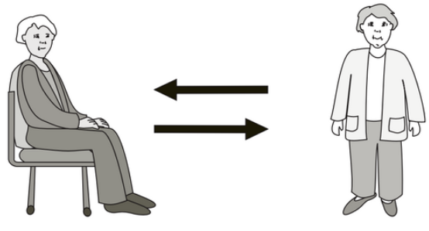


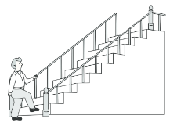
Our GOALS for discharge from hospital.
Goals may change
TRANSFERS
  Independent
  Supervision
  Assistance from ______ person(s)
  Too early to predict
  _________________________________________
WALKING / AMBULATION
  Independent
  Supervision
  Assistance from ______ person(s)
  Too early to predict
  _________________________________________
STAIRS
  Independent
  Supervision
  Assistance from ______ person(s)
  Too early to predict
  _________________________________________
Images used are from ParticiPics – a free, searchable database of pictographic images developed by the Aphasia Institute, ​https://www.aphasia.ca/participics

Slide 4


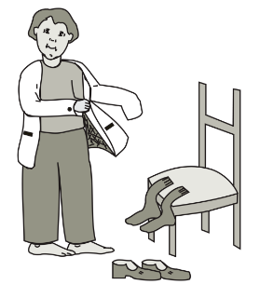
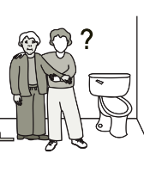
Our GOALS for discharge from hospital.
Goals may change
BATHING
Sink Shower
Assistive devices
Independent
Assistance from ______ person(s)
______________________________________________
DRESSING
Assistive devices
Independent
Assistance from ______ person(s)
______________________________________________
TOILETING
Assistive devices
May need incontinence care
Independent
Assistance from ______ person(s)
______________________________________________
Images used are from ParticiPics – a free, searchable database of pictographic images developed by the Aphasia Institute, ​https://www.aphasia.ca/participics

Slide 5

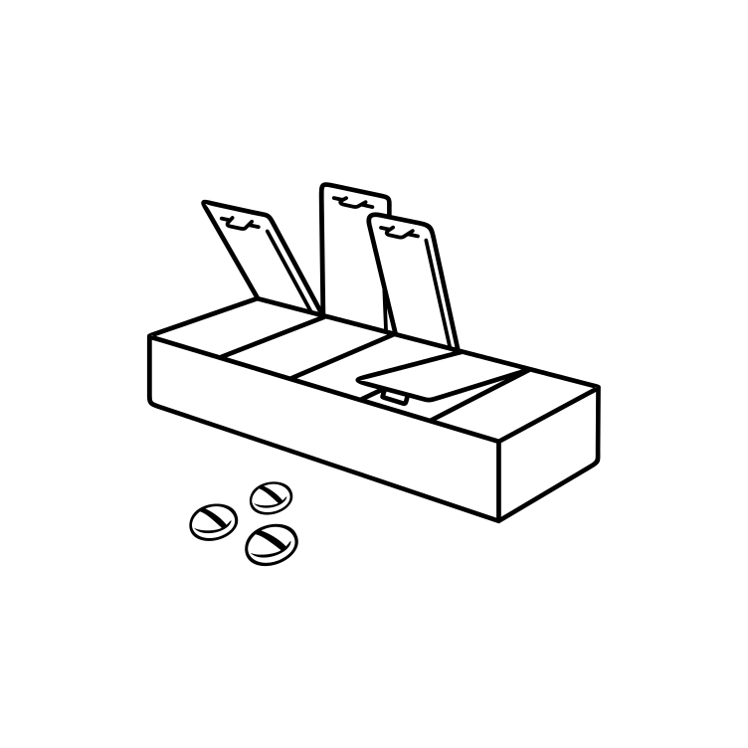



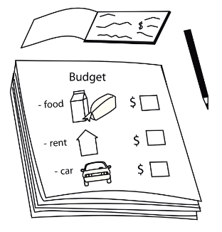


Our GOALS for discharge from hospital.
Goals may change
SAFETY AT HOME ALONE:
  Likely safe
  Likely unsafe:__________________________
  Too early to predict
MANAGING MEDICATIONS
  Likely to need assistance
  Likely to manage independently
  Too early to predict
COOKING
  Likely to need assistance
  Likely to manage independently
  Too early to predict
FINANCES
  Likely to need assistance
  Likely to manage independently
  Too early to predict
Images used are from ParticiPics – a free, searchable database of pictographic images developed by the Aphasia Institute, ​https://www.aphasia.ca/participics

Slide 6








Our GOALS for discharge from hospital.
Goals may change
SPEAKING
  Independent
  Words Phrases Sentences
  Strategies:________________________________
LISTENING
  Independent
  Words Phrases Sentences
  Strategies:________________________________
READING
  Independent
  Words Phrases Sentences
  Strategies:________________________________
WRITING
  Independent
  Words Phrases Sentences
  Strategies:________________________________
  Independent Assistance
  Strategies:________________________________
COGNITIVE-LINGUISTIC SKILLS
Images used are from ParticiPics – a free, searchable database of pictographic images developed by the Aphasia Institute, ​https://www.aphasia.ca/participics

Slide 7




Swallow Strategies
Questions? ​​

Slide 8
Nos OBJECTIFS pour la sortie de l'hôpital.
Les objectifs peuvent changer
TRANSFERTS
  Indépendent
  Supervision
  Assistance de ______ personne(s)
  Trop tôt pour prévoir
  _________________________________________
MARCHER / AMBULATION
  Indépendent
  Supervision
  Assistance de ______ personne(s)
  Trop tôt pour prévoir
  _________________________________________
ESCALIERS
  Indépendent
  Supervision
  Assistance de ______ personne(s)
  Trop tôt pour prévoir
  _________________________________________
Images used are from ParticiPics – a free, searchable database of pictographic images developed by the Aphasia Institute, ​https://www.aphasia.ca/participics

Slide 9
Nos OBJECTIFS pour la sortie de l'hôpital.
Les objectifs peuvent changer
SE LAVER
Lavabo Douche
Équipement d'assistance
Indépendent
Assistance de ______ personne(s)
______________________________________________
S'HABILLER
Équipement d'assistance
Indépendent
Assistance de ______ personne(s)
______________________________________________
TOILETTE
Équipement d'assistance
Peut avoir besoin de soins d'incontinence
Indépendent
Assistance de ______ personne(s)
______________________________________________
Images used are from ParticiPics – a free, searchable database of pictographic images developed by the Aphasia Institute, ​https://www.aphasia.ca/participics

Slide 10
Nos OBJECTIFS pour la sortie de l'hôpital.
Les objectifs peuvent changer
SÉCURITÉ À LA MAISON SEUL:
  Probablement sécuritaire
  Probablement à risque:__________________
  Trop tôt pour prédire
GESTION DES MÉDICAMENTS
  Avoir besoin d'aide
  Se débrouiller seul
  Trop tôt pour prédire
CUISINER
  Avoir besoin d'aide
  Se débrouiller seul
  Trop tôt pour prédire
FINANCES
  Avoir besoin d'aide
  Se débrouiller seul
  Trop tôt pour prédire
Images used are from ParticiPics – a free, searchable database of pictographic images developed by the Aphasia Institute, ​https://www.aphasia.ca/participics

Slide 11
Nos OBJECTIFS pour la sortie de l'hôpital.
Les objectifs peuvent changer
PARLER
  Indépendent
  Mots Phrases courtes Phrases longues
  Stratégies:________________________________
ÉCOUTER
  Indépendent
  Mots Phrases courtes Phrases longues
  Stratégies:________________________________
LIRE
  Indépendent
  Mots Phrases courtes Phrases longues
  Stratégies:________________________________
ÉCRIRE
  Indépendent
  Mots Phrases courtes Phrases longues
  Stratégies:________________________________
  Indépendent Assistance
  Stratégies:________________________________
HABILETÉS COGNITIVOLINGUISTIQUES
Images used are from ParticiPics – a free, searchable database of pictographic images developed by the Aphasia Institute, ​https://www.aphasia.ca/participics

Slide 12
Stratégies de déglutition
Questions? ​​

