Slide 1


Discharge Handout
Aphasia-friendly toolkit Feb 2024
Disclaimer: These materials were created using funding from the Provincial Community Stroke Rehabilitation Initiative and crafted by Aran Oberle, Speech Language Pathologist, with input from regional rehab programs. They are not meant to replace professional expertise. Readers should seek advice from a qualified healthcare provider for any concerns. The content of this PowerPoint can be adjusted to suit the needs of healthcare professionals. Users are accountable for confirming the accuracy and suitability of the information for their unique situations.

Slide 2

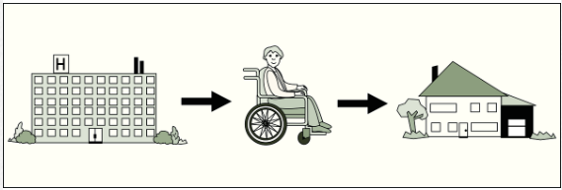
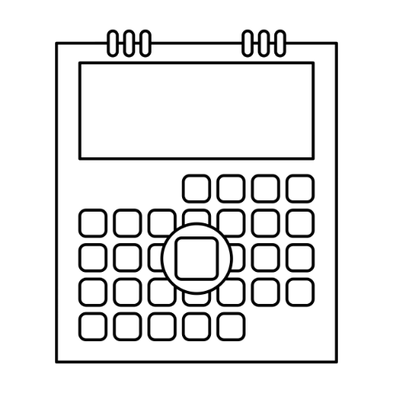


Discharge
Date: ________________________________
Time: ________________________________
Place:_______________________________
______________________________________
______________________________________
Images used are from ParticiPics – a free, searchable database of pictographic images developed by the Aphasia Institute, ​https://www.aphasia.ca/participics

Slide 3
Congé
Date: ________________________________
Heure: ________________________________
Endroit:________________________________
______________________________________
______________________________________
Images used are from ParticiPics – a free, searchable database of pictographic images developed by the Aphasia Institute, ​https://www.aphasia.ca/participics

