Slide 1


Deep Breathing
Exercises
Aphasia-friendly toolkit Feb 2024
Disclaimer: These materials were created using funding from the Provincial Community Stroke Rehabilitation Initiative and crafted by Aran Oberle, Speech Language Pathologist, with input from regional rehab programs. They are not meant to replace professional expertise. Readers should seek advice from a qualified healthcare provider for any concerns. The content of this PowerPoint can be adjusted to suit the needs of healthcare professionals. Users are accountable for confirming the accuracy and suitability of the information for their unique situations.

Slide 2

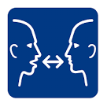
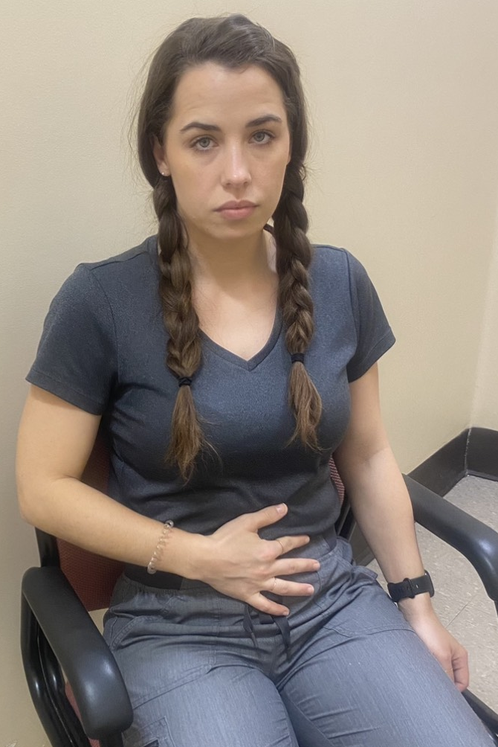
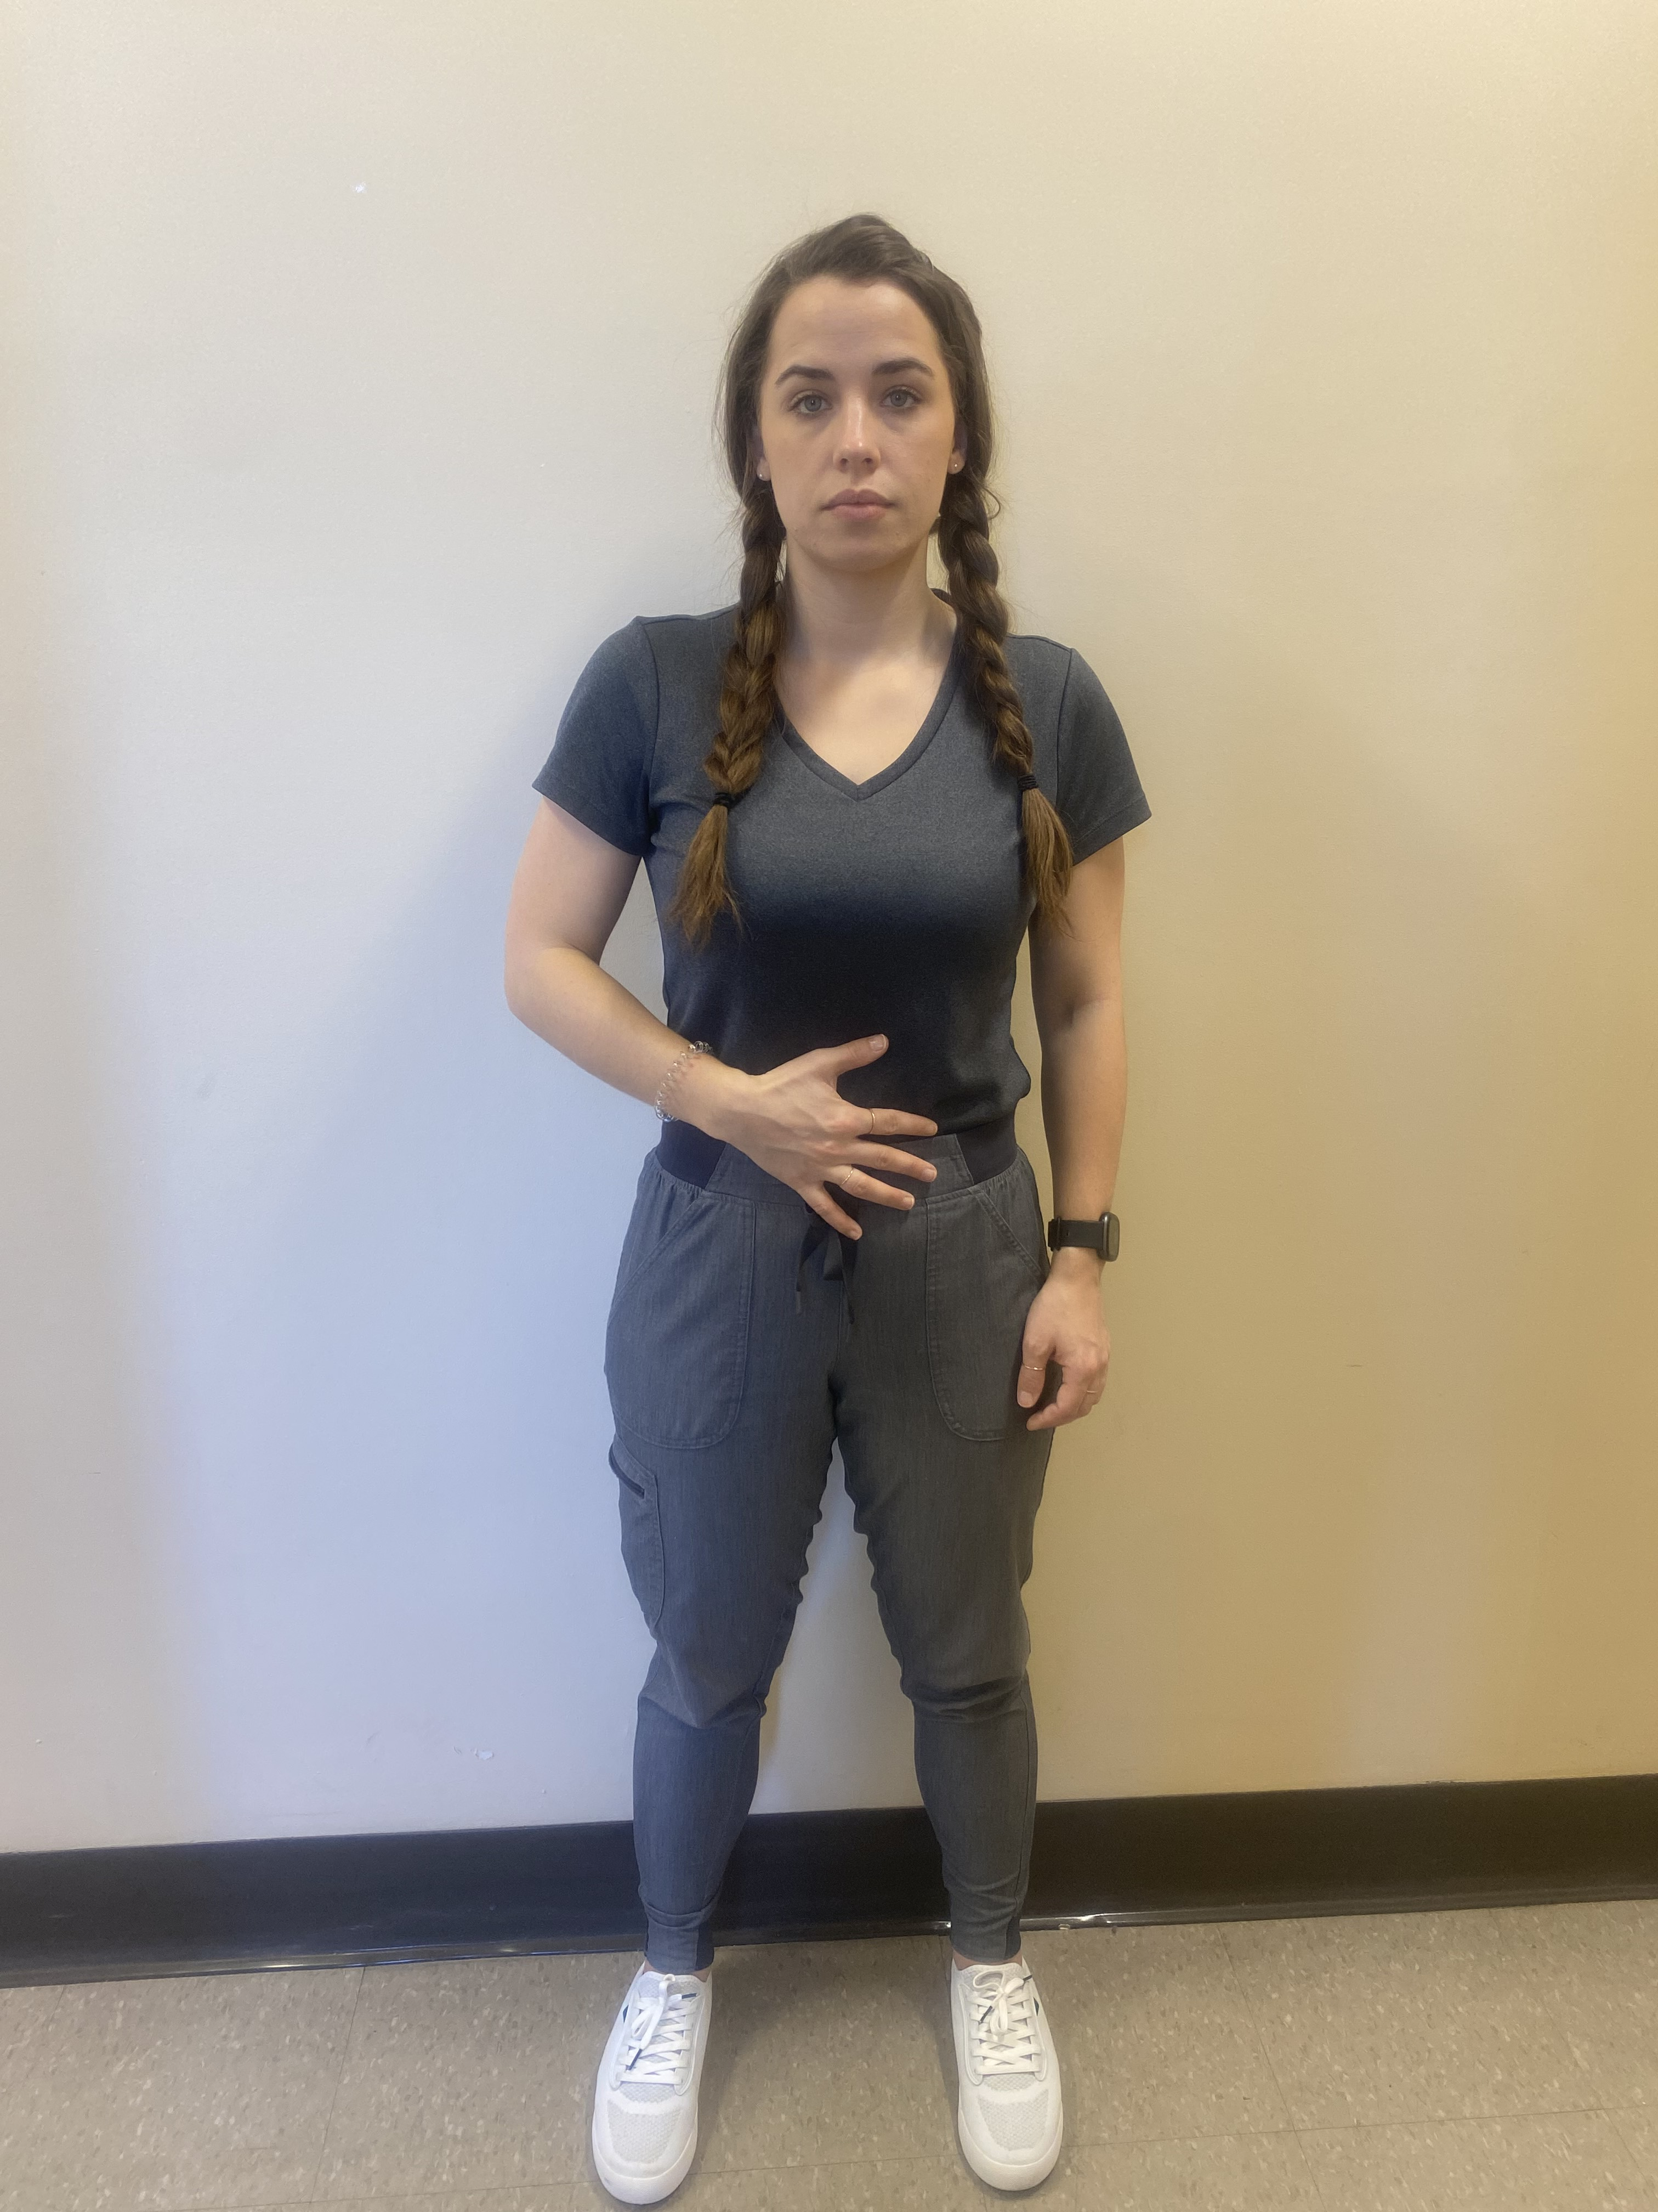
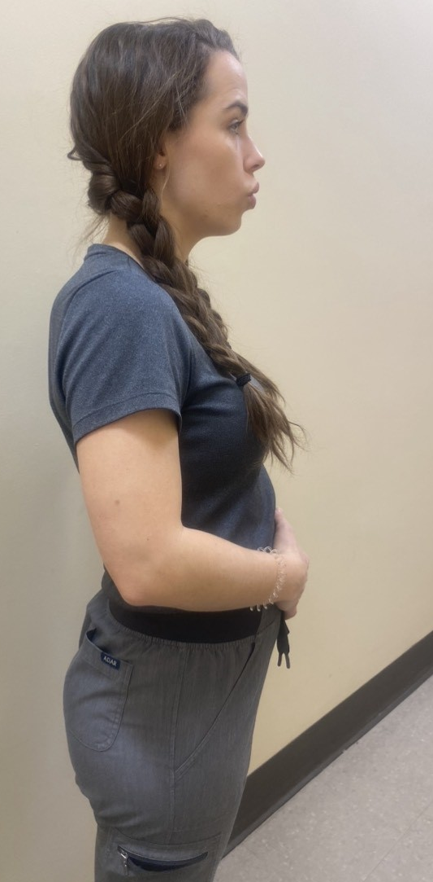
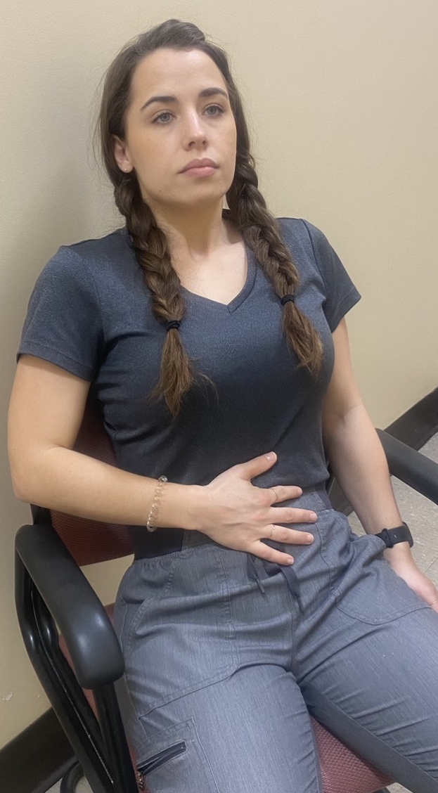
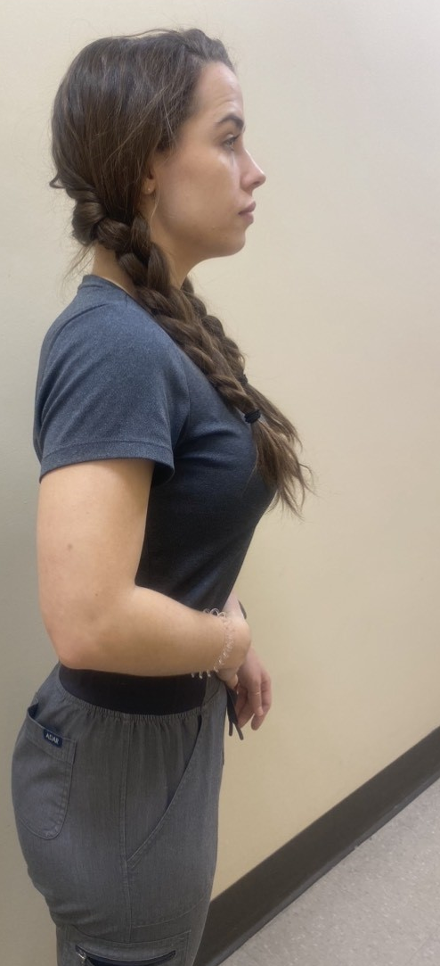
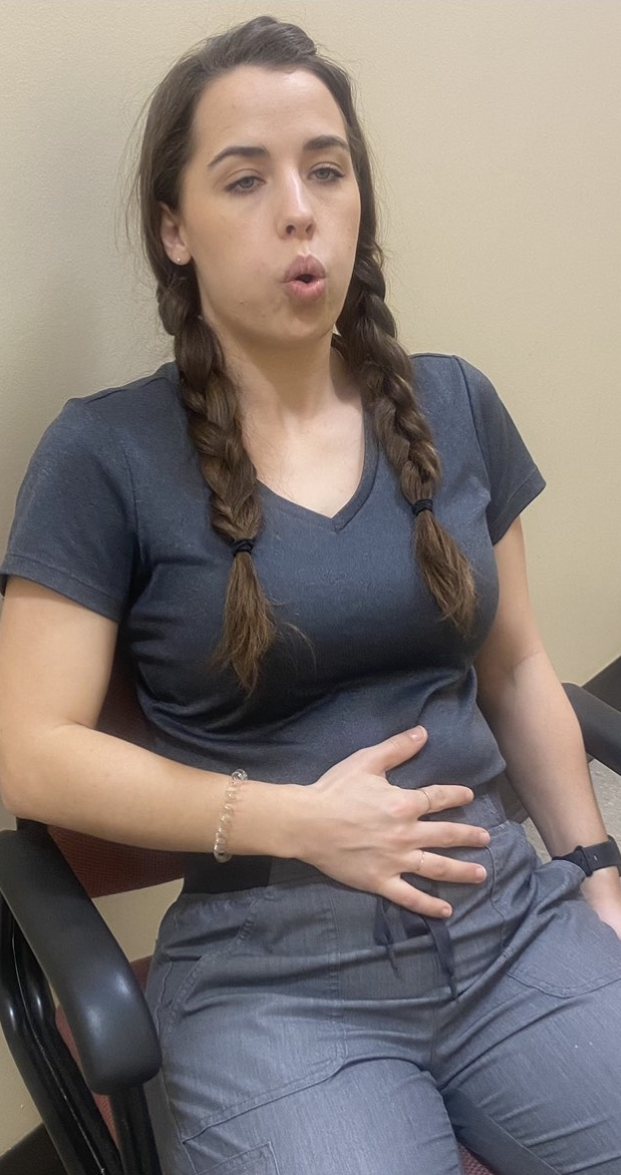
Deep Breathing Exercises
Repeat exercise __ times with mirror
Place hand on stomach
Breathe in through nose slowly
Feel stomach expand as
diaphragm pulls air into lungs
Breathe out through mouth slowly
Feel stomach contract as
diaphragm pushes air out
Repeat ______ times

Slide 3
Exercices de respiration profonde
À répéter __ fois avec miroir
Mettez la main sur le ventre
Inspirez lentement par le nez
Sentez le ventre se gonfler lorsque le diaphragme tire l’air vers les poumons
Expirez lentement par la bouche
Sentez le ventre se contracter lorsque le diaphragme repousse l’air
Répétez ______ fois

