Slide 1


Circle of Care
Aphasia-friendly toolkit Feb 2024
Disclaimer: These materials were created using funding from the Provincial Community Stroke Rehabilitation Initiative and crafted by Aran Oberle, Speech Language Pathologist, with input from regional rehab programs. They are not meant to replace professional expertise. Readers should seek advice from a qualified healthcare provider for any concerns. The content of this PowerPoint can be adjusted to suit the needs of healthcare professionals. Users are accountable for confirming the accuracy and suitability of the information for their unique situations.

Slide 2







My Rehab Team
Doctor:
____________________________________________________
Physiatrist:
____________________________________________________
Pharmacist:
____________________________________________________
Dietitian (RD):
____________________________________________________
Social Worker (SW):
____________________________________________________
Social Service Worker (SSW):
____________________________________________________

Slide 3

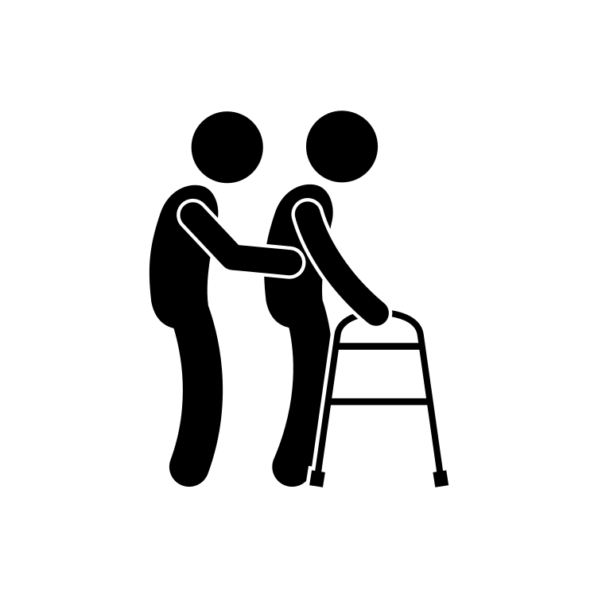
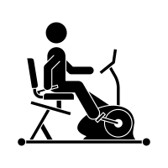


My Rehab Team
Occupational Therapist (OT):
____________________________________________________
Physiotherapist (PT):
____________________________________________________
Rehab Assistant (RA):
____________________________________________________
Speech-Language Pathologist (SLP):
____________________________________________________
Communication Disorders Assistant (CDA):
____________________________________________________

Slide 4


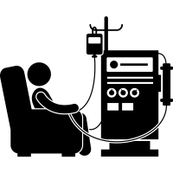
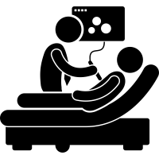

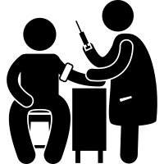

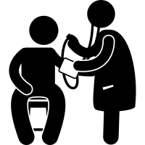


My Rehab Team
____________________________________________________
____________________________________________________
____________________________________________________
____________________________________________________
____________________________________________________
____________________________________________________
____________________________________________________
____________________________________________________
____________________________________________________
____________________________________________________
____________________________________________________

Slide 5











My Rehab Team
____________________________________________________
____________________________________________________
____________________________________________________
____________________________________________________
____________________________________________________
____________________________________________________
____________________________________________________
____________________________________________________
____________________________________________________
____________________________________________________
____________________________________________________

Slide 6

Mon équipe interprofessionelle
Médecin:
____________________________________________________
Physiatre:
____________________________________________________
Pharmaciste:
____________________________________________________
Ergothérapeute (OT):
____________________________________________________
Physiothérapeute (PT):
____________________________________________________
Orthophoniste (SLP):
____________________________________________________
Travailleur(euse) Socale (SW):
____________________________________________________
Diététicien(ne) (RD):
____________________________________________________
Assistant(e) en orthophonie (CDA):
____________________________________________________
Assistant(e) de réadaptation (RA):
____________________________________________________
Psychologue:
____________________________________________________

Slide 7
Mon équipe interprofessionelle
Médecin:
____________________________________________________
Physiatre:
____________________________________________________
Pharmaciste:
____________________________________________________
Diététicien(ne) (RD):
____________________________________________________
Travailleur(euse) Socale (SW):
____________________________________________________
Travailleur(euse) des Services Socaux (SSW):
____________________________________________________

Slide 8
Mon équipe interprofessionelle
Ergothérapeute (OT):
____________________________________________________
Physiothérapeute (PT):
____________________________________________________
Assistant(e) de réadaptation (RA):
____________________________________________________
Orthophoniste (SLP):
____________________________________________________
Assistant(e) en orthophonie (CDA):
____________________________________________________

Slide 9
Mon équipe interprofessionelle
____________________________________________________
____________________________________________________
____________________________________________________
____________________________________________________
____________________________________________________
____________________________________________________
____________________________________________________
____________________________________________________
____________________________________________________
____________________________________________________
____________________________________________________

Slide 10
Mon équipe interprofessionelle
____________________________________________________
____________________________________________________
____________________________________________________
____________________________________________________
____________________________________________________
____________________________________________________
____________________________________________________
____________________________________________________
____________________________________________________
____________________________________________________
____________________________________________________

